Slide 1
Working directory in VMD
Created : 2021/06/29
Created by Yoyo, Jeff
Last edit : 2021/06/29

Slide 2
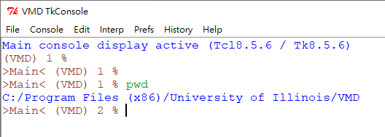
The default working directory in VMD.
Use “pwd” to check default working directory path when initially run VMD.
Use “cd” to change current working directory path to new ones.
Changing working directory for personal need.
The name in the brackets also provide a info that your current working directory name is.

Slide 3
Path of VMD output file :
Ans : Check your working directory or the command/script where indicate the path output file
save.

